Slide 1
Project Chimera
By: William Estep
Brandon ward
Joshua stanton

Slide 2


Problem Definition
General media is flooded with information and examining all the information on a casual basis is an impossible task.
Current search engines are either too broad or too specific for many people who have a general idea what they want, but nothing concrete.
Specifically, almost everyone today is searching for forms of entertainment and an incredible amount of differing varieties of entertainment are being produced.
For the regular person, navigating this massive pile of media is more work then they are willing to deal with.

Slide 3
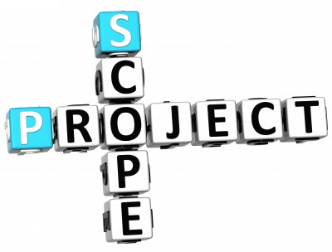
Project Scope
Project Chimera is intended as an android mobile application.
The main functional pieces of Project Chimera will be based on the ability to rapidly search a database of multiple types of entertainment media and provide suggestions for the user.
Users will be able to login and have their own preferences and other pieces of information to increase the efficiency of the database search.
The majority of the data will be stored on a server to be accessed when the application is running.

Slide 4
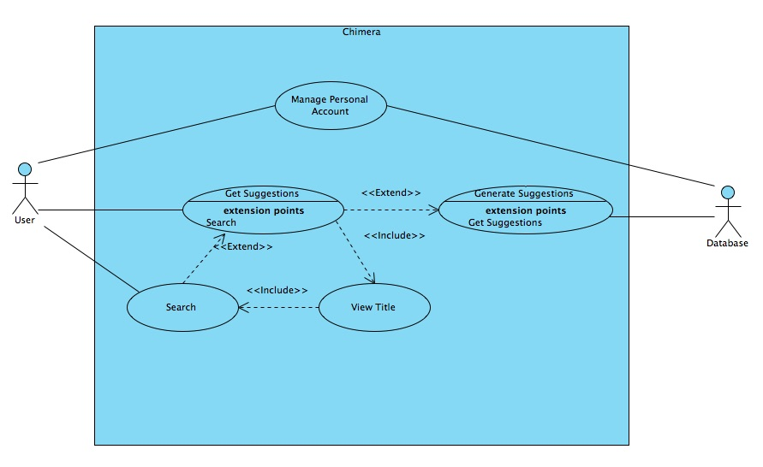
Use Case Diagram

Slide 5
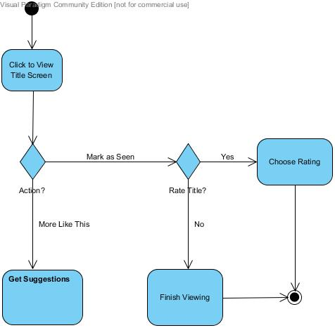
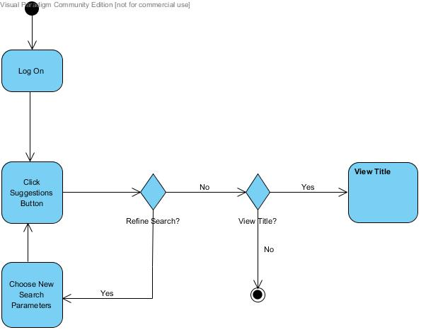

Use Cases: Get Suggestions, View Titles, and Search

Slide 6
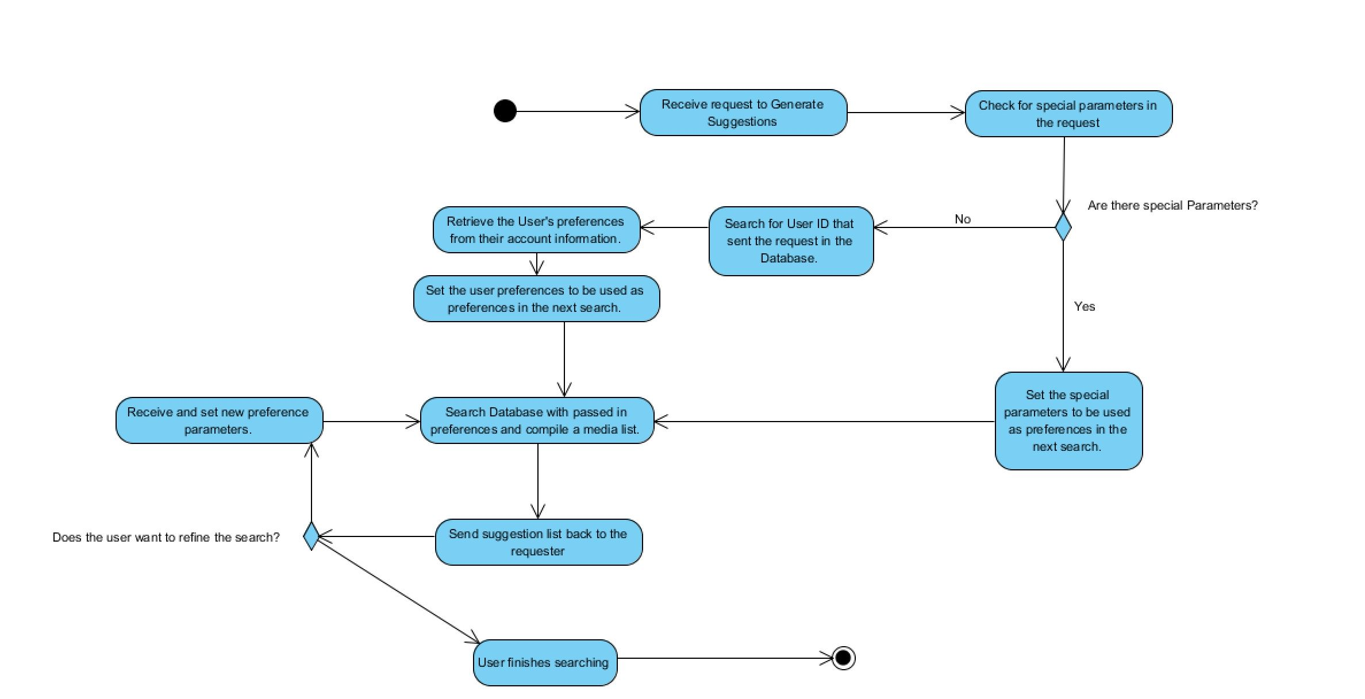
Use Case: Generate Suggestions

Slide 7
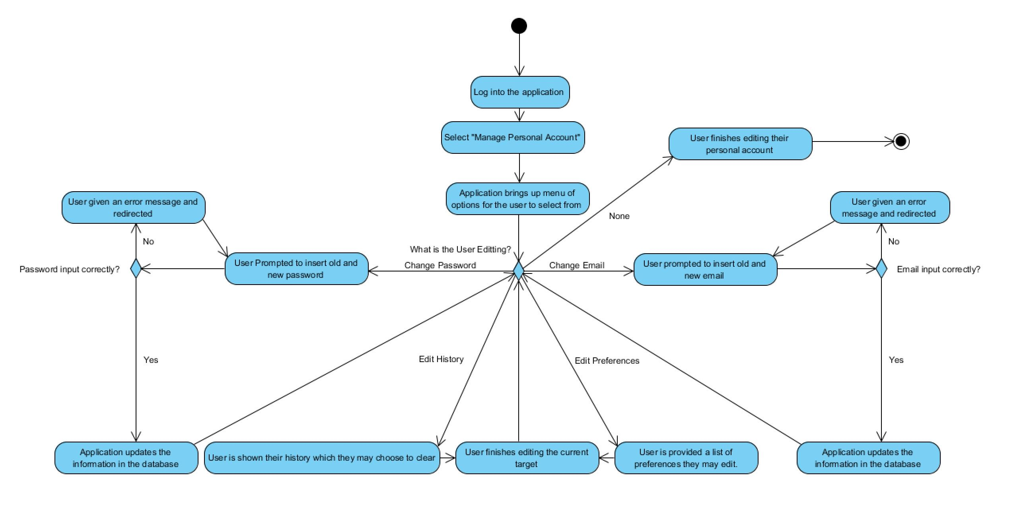
Use Case: Manage Personal Account

Slide 8
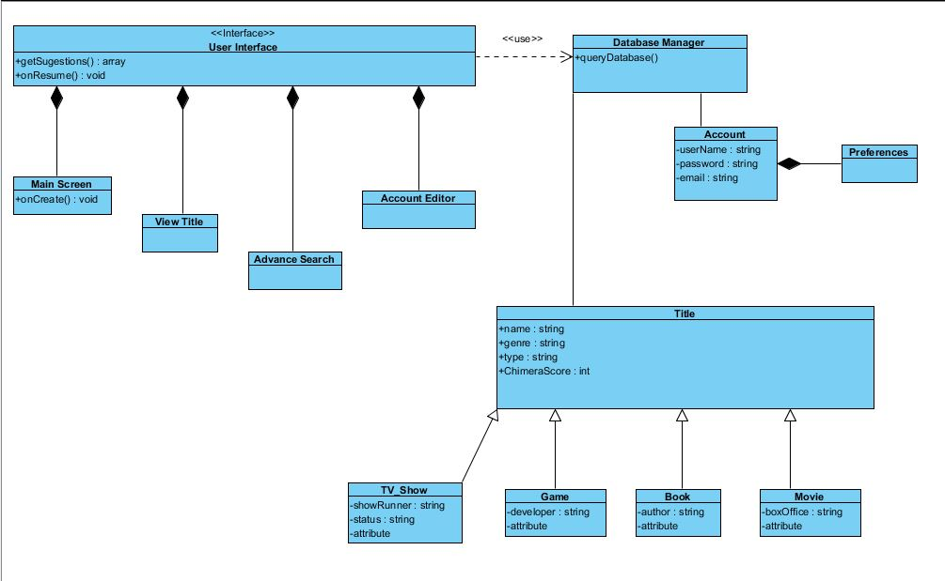
Class Diagram

Slide 9

Features
Necessary Features
Cross Media Database
Android Application
User Interface
Networking utilization between the database and application
Method to aggregate information in the database.
Algorithm to calculate suggestions based on different criteria
Rating System for titles
Additional Features
Viewing History log for users
User logic across devices
Availability of Items suggested

Slide 10

Potential Risks
The Cross Media database proves to inefficient to parse for use recommendations due to the quantity of data.
The possibility that users primarily use our utility when they lack a connection, resulting in the application failing.
The broad target audience of the application proves too broad and more specific searches end up being the preferred solution to the problem.

Slide 11
Summary
The purpose of Project Chimera is to develop a mobile application and database to allow us to dynamically recommend various forms of media entertainment. It is also to create an intuitive and adaptive User Interface for users to access and retrieve information from a database of compiled information on various forms of entertainment media. This purpose is motivated by the desire to be able to find specific forms of entertainment that appeal to specific personalities rapidly and with little work on part of the individual.

